Slide 1
Malignant Comments Classifier
Presented By
Aamina Ruvaida

Slide 2
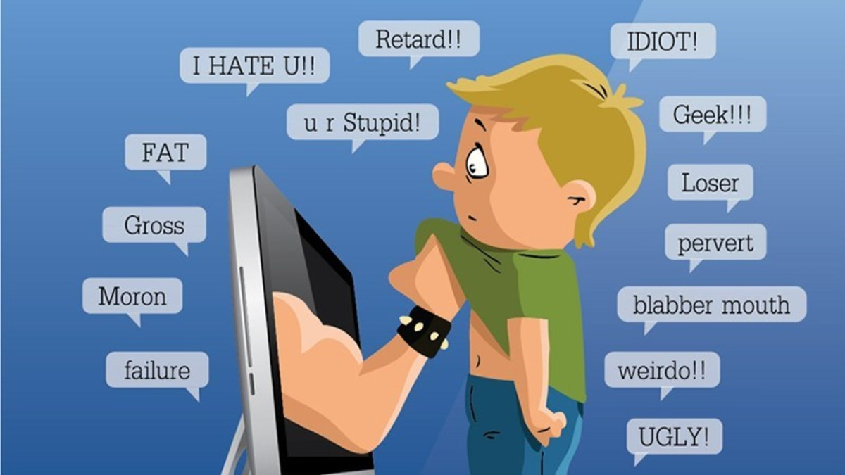

Slide 3

Agenda
Introduction
Problem Statement
Problem Understanding
Exploratory Data Analysis
Data Visualization
Data Pre-Processing
Model Dashboards
Model Building
Cross Validation
Hyper Parameter Tuning
Finalized Model
Model Prediction
Conclusion

Slide 4


Introduction
These comments which here are referred as malignant here represents the human behaviour as well as tendency of the individual in the society.
Malignant: It is the Label column, which includes values 0 and 1, denoting if the comment is malignant or not. Highly Malignant: It denotes comments that are highly malignant and hurtful. Rude: It denotes comments that are very rude and offensive.
In the Social Media, we praise someone for the achievement and as well we express our feeling. If something happens against, people express hatred, disrespectful comments in the social media. Which makes the other person to be depressed, hurt and feel bad.

Slide 5
Problem Statement
The proliferation of social media enables people to express their opinions widely online. However, at the same time, this has resulted in the emergence of conflict and hate, making online environments uninviting for users. Although researchers have found that hate is a problem across multiple platforms, there is a lack of models for online hate detection.
Online hate, described as abusive language, aggression, cyberbullying, hatefulness and many others has been identified as a major threat on online social media platforms. Social media platforms are the most prominent grounds for such toxic behaviour. There has been a remarkable increase in the cases of cyberbullying and trolls on various social media platforms. Many celebrities and influences are facing backlashes from people and have to come across hateful and offensive comments.
This can take a toll on anyone and affect them mentally leading to depression, mental illness, self-hatred and suicidal thoughts. Internet comments are bastions of hatred and vitriol. While online anonymity has provided a new outlet for aggression and hate speech, machine learning can be used to fight it.
The problem we sought to solve was the tagging of internet comments that are aggressive towards other users. This means that insults to third parties such as celebrities will be tagged as unoffensive, but “u are an idiot” is clearly offensive.
Our goal is to build a prototype of online hate and abuse comment classifier which can used to classify hate and offensive comments so that it can be controlled and restricted from spreading hatred and cyberbullying.

Slide 6

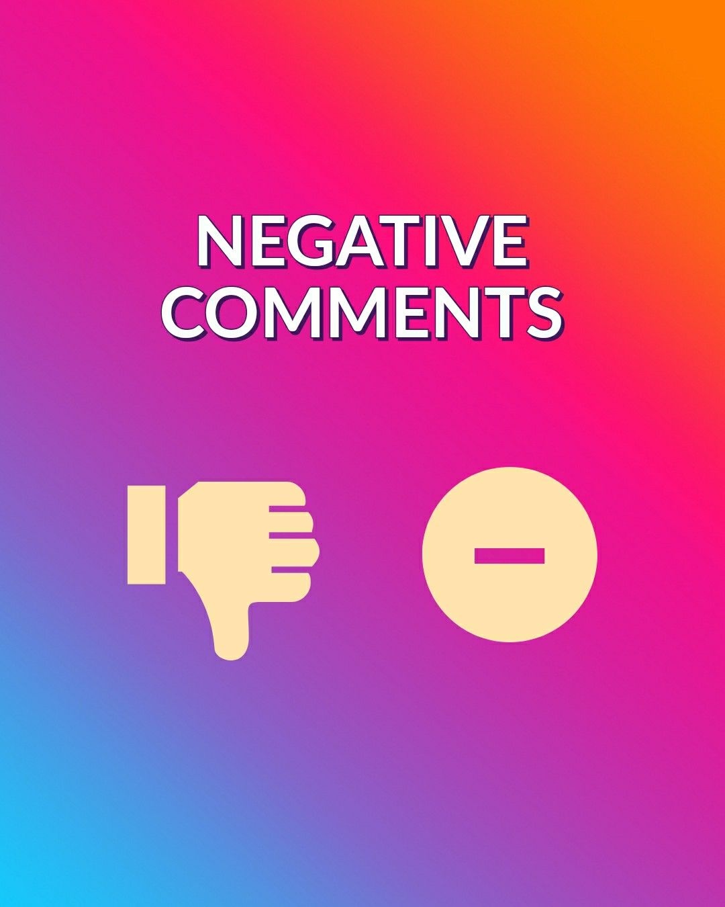
Problem Understating
Deleting a genuine negative comment (trolls are an exception) is never a good thing to do on social media. It straightaway raises questions on the brand’s integrity. It may also stoke the customer’s anger and frustration and cause him to post a flurry of negative comments on various platforms, which may eventually boil over into an uncontrollable situation. There are also good chances that the comment may have already been seen and possibly even saved as a screenshot by other customers.
It is best to respond as quickly as possible to negative comments. Irate customers generally lack patience and expect quick resolution of issues. Undue delays could only make matters worse.
Most negative comments left on Social Media are complaints left by unhappy customers.
“Disaster gave me two things: a moment to react and a decision to overcome”

Slide 7
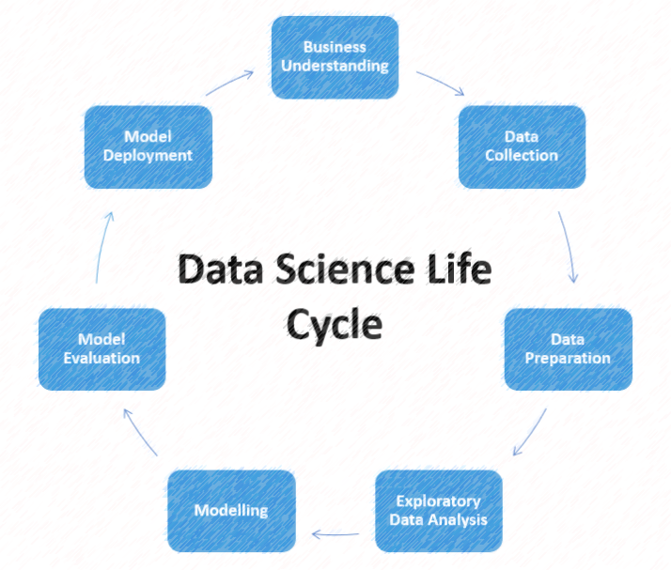

Slide 8
Exploratory Data Analysis
Imported the necessary libraries and loaded the train and test data set.
There are 159571 rows and 8 columns present in the train dataset.
There are 153164 rows and 2 columns present in the test dataset.
Checked the shape, info, data types, statistical summary of data, count of value.
We checked the null value, there is no null value present in the data.
Dropped the id column from the train dataset
Visualized the data using various plot. Box plot, distribution plot, scatterplot, countplot, regplot, pie chart to analysis the data.
Using the word cloud, we have visualize the frequently used bad comments.
We have filter the comments that have the stop words, punctuations etc using the nltk.
Using the Imbalance technique, we have balance the data.
Done the feature engineering, data pre-processing , data cleaning.
Checked the correlation of data and visualized it using heatmap.
Then we have separate the feature and target into x and y. Then we have build the machine learning model, using the metrics we have checked the accuracy score, classification report, confusion matrix, log loss, Visualization the AOC ROC Curve, done the hyper parameter tuning. and make the comments prediction.

Slide 9
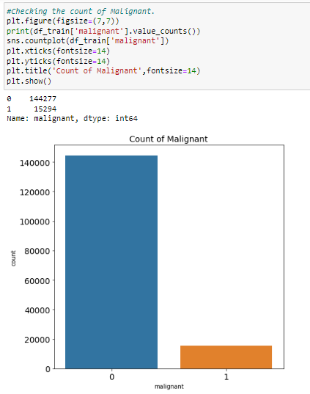
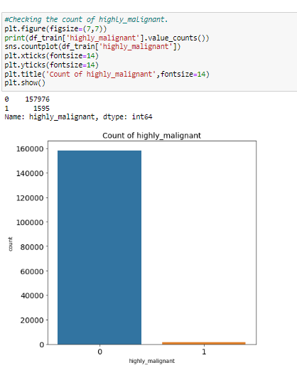
Visualization
Highly
Malignant
Malignant
In malignant the bad comments count is 15294 and highly malignant bad comments count is 1595. We see that Malignant bad comments count is high as compare to highly malignant.

Slide 10
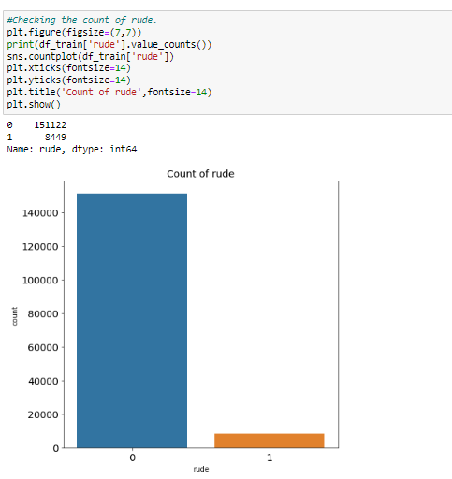
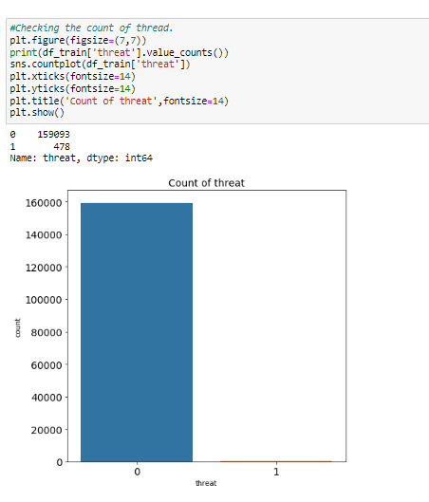
Rude
Threat
In rude the bad comments count is 8449 and in threat the bad comments count is 478. Majority of people comments vert rudely. We should avoid such behaviour in the public platform. As it make our appearance bad, people will judge us the way we make them feel.

Slide 11
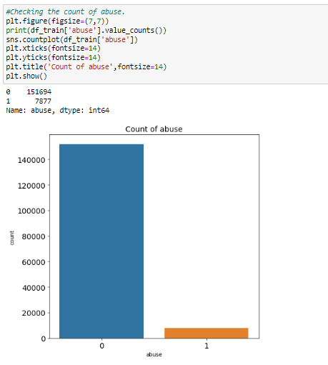
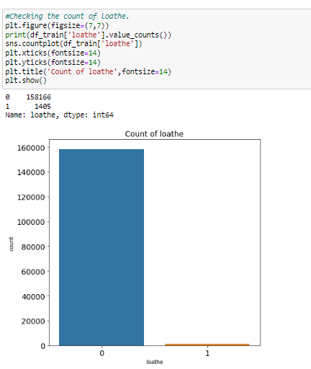
Abuse
Loathe
In abuse bad comments count is 7877 and in Loathe the bad comments count is 1405. Majority of people use the abusive language in social media. We should avoid such abusive words used in the media and spread the positive word in the comments.

Slide 12
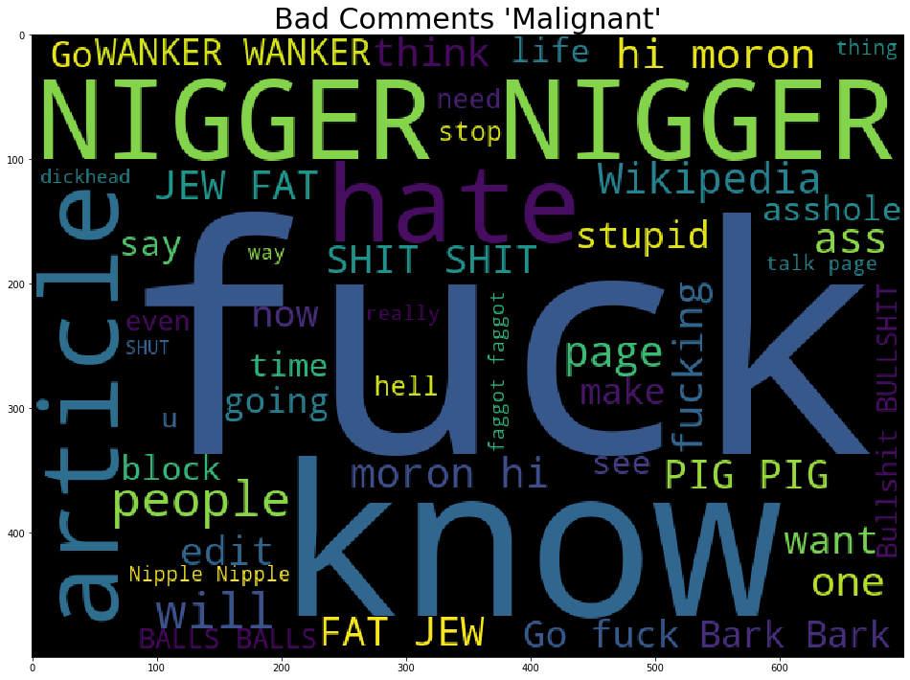
Frequently used bad comments in Malignant

Slide 13
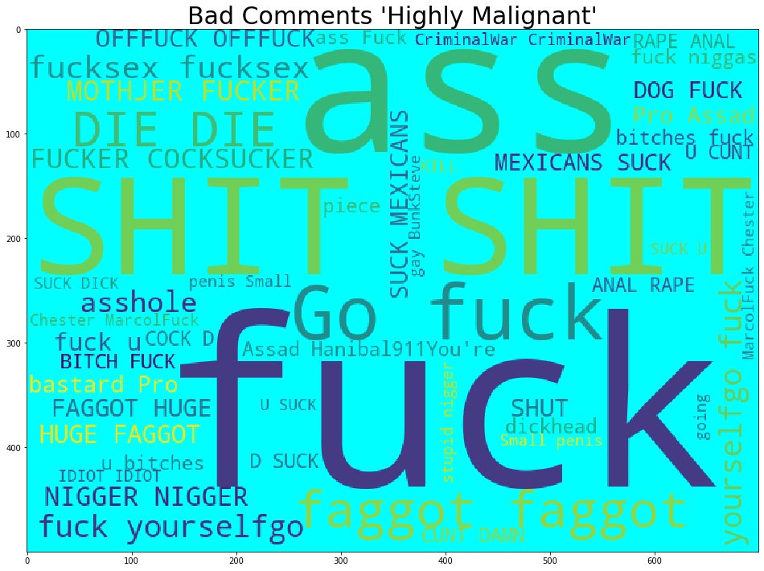
Frequently used bad comments in Highly Malignant

Slide 14
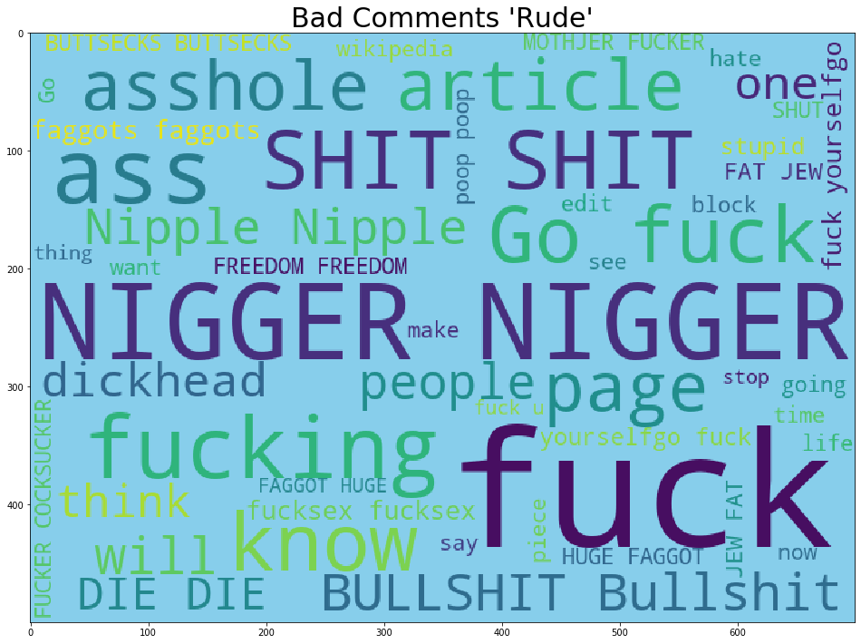
Frequently used bad comments in Rude

Slide 15
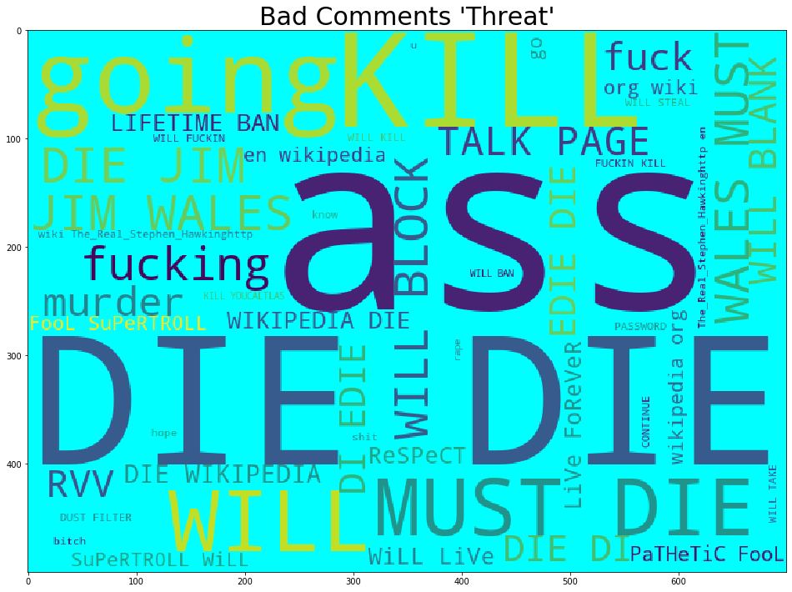
Frequently used bad comments in Threat

Slide 16
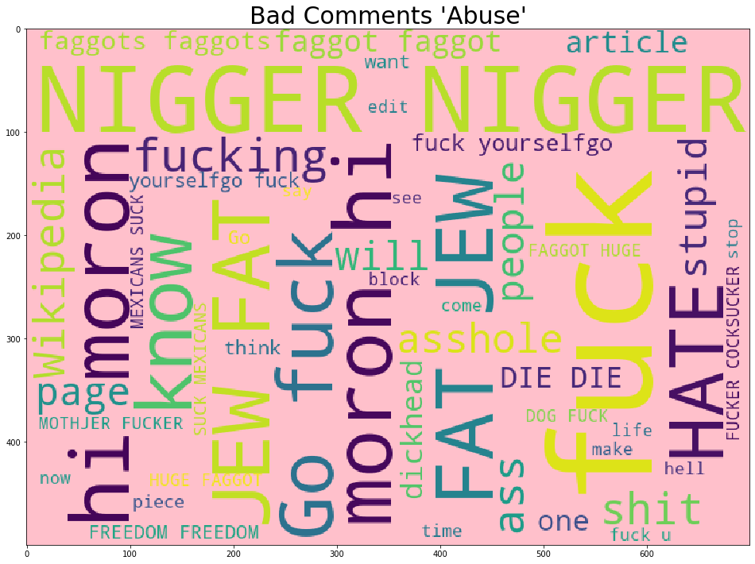
Frequently used bad comments in Abuse

Slide 17
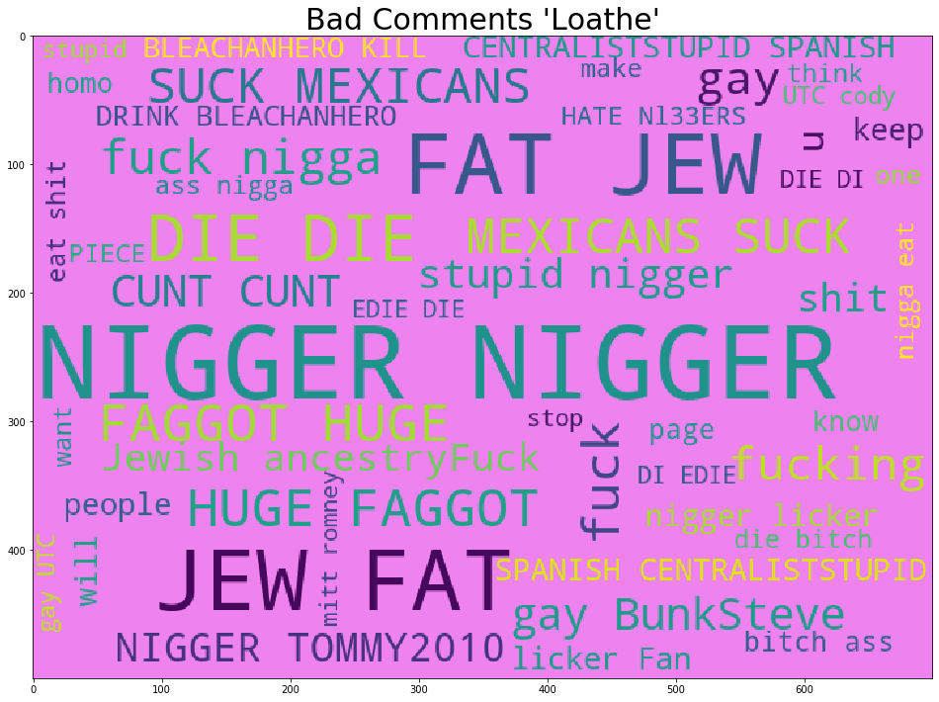
Frequently used bad comments in Loathe

Slide 18
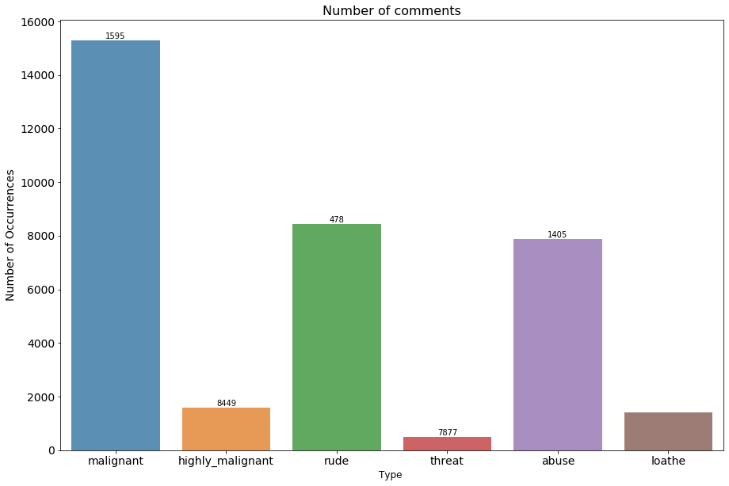
Number of bad comments in Each class

Slide 19
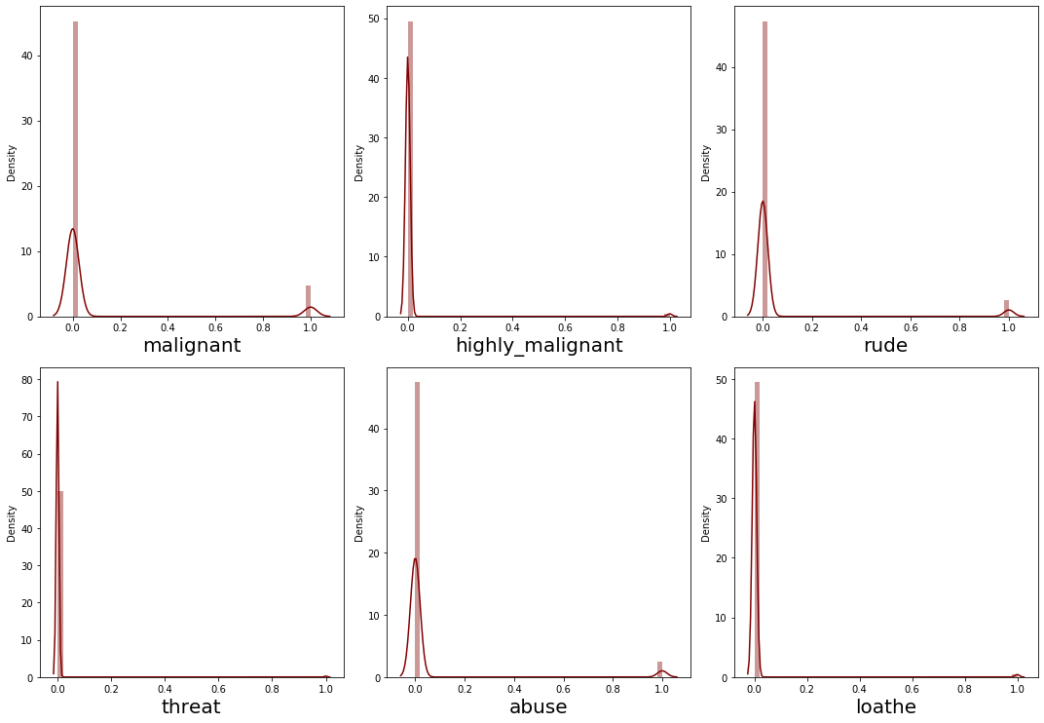
Distribution Plot

Slide 20
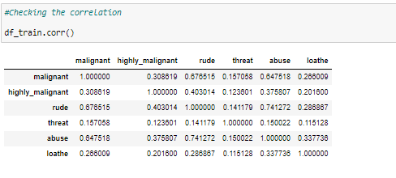
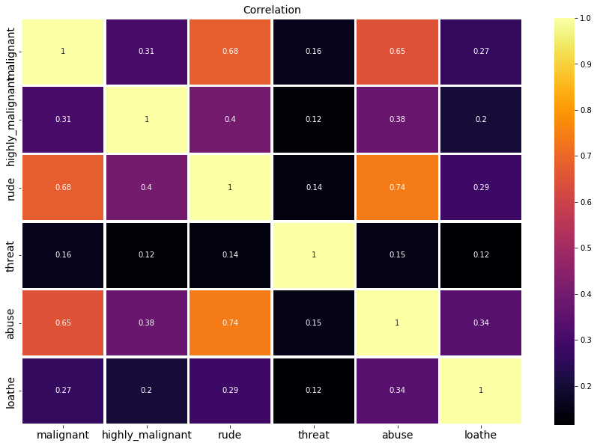
Correlation
We can see the correlation of each class. Malignant is high correlated than other classes. Loathe is less correlated.

Slide 21
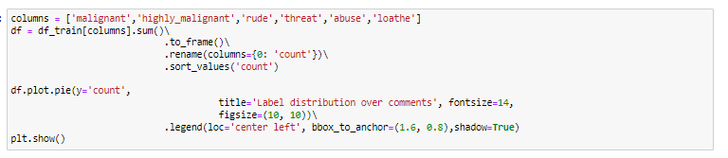
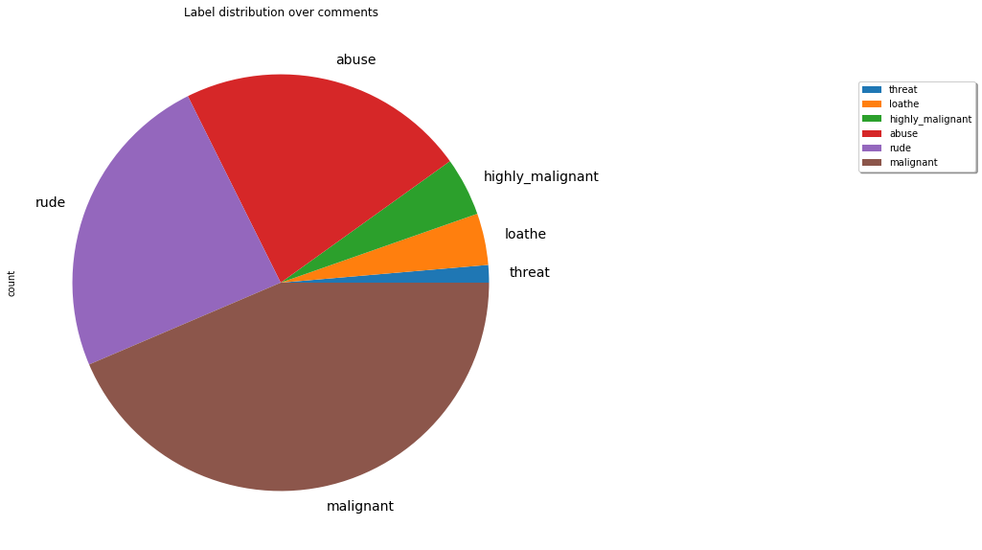
Pie Chart
In this pie chart we see that majority of comments comes under the malignant category. Then comes next rude. Abuse. Least bad comments comes under the threat category.

Slide 22
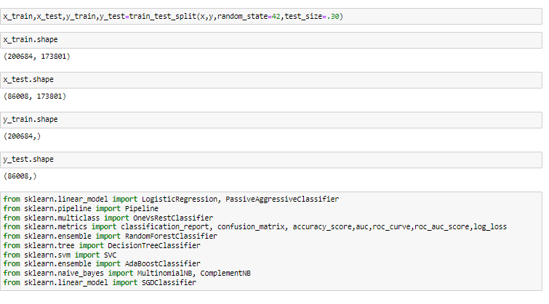
Model Building
Splitted the data into x and y variable.
Before that our target variable is imbalance. We have balanced the data using SMOTE Technique.
Imported the Machine Learning Algorithm Libraries.
We have splitted the 70 percent of data for training and 30 percent of data for testing.
We have splitted into x_train, y_train, x_test, y_test for training and testing the model and make the prediction.

Slide 23

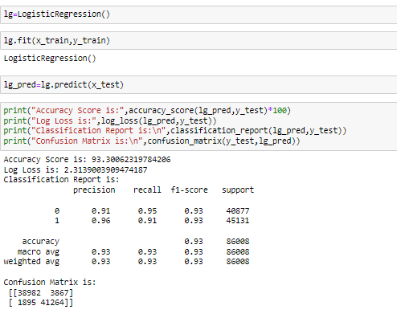
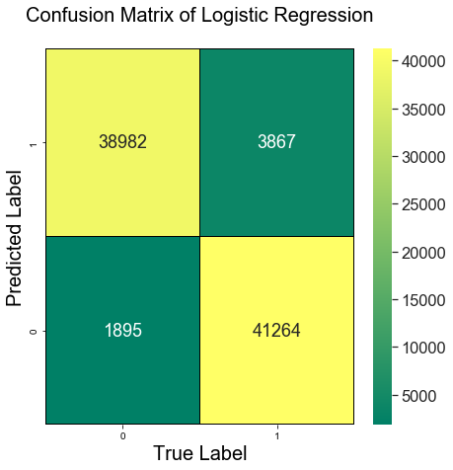
Logistic Regression
In Logistic Regression the accuracy score is 93%. Our Log Loss is 2.3. In the above we see the classification report and confusion matrix.

Slide 24
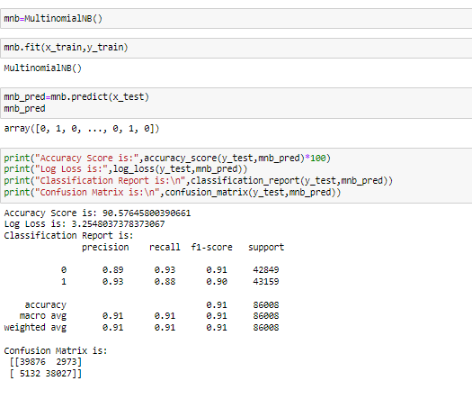
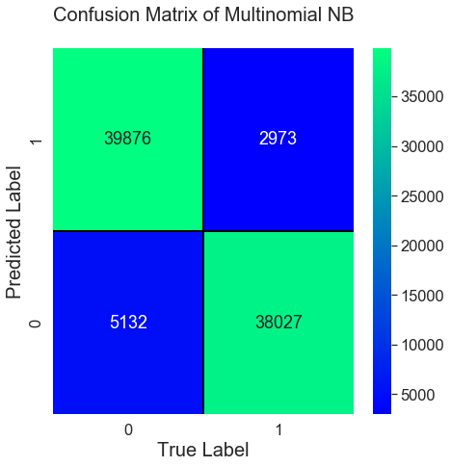
Multinomial NB
In Multinomial NB the accuracy score is 90%. Our Log Loss is 3.2. In the above we see the classification report and confusion matrix.

Slide 25
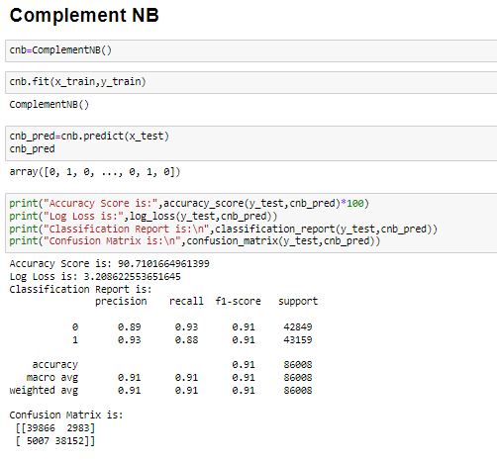
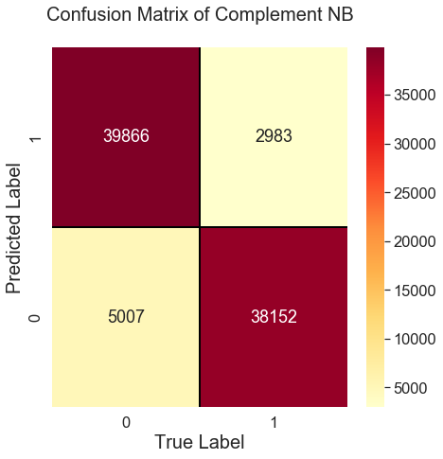
Complement NB
In Complement NB the accuracy score is 91%. Our Log Loss is 3.2. In the above we see the classification report and confusion matrix.

Slide 26
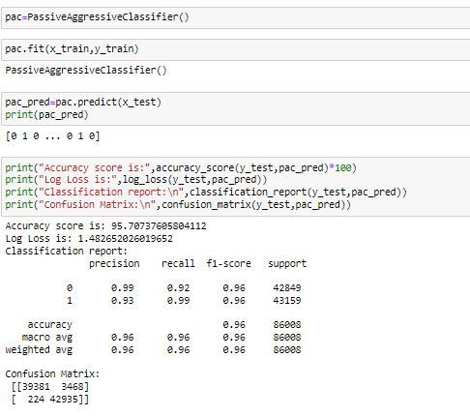
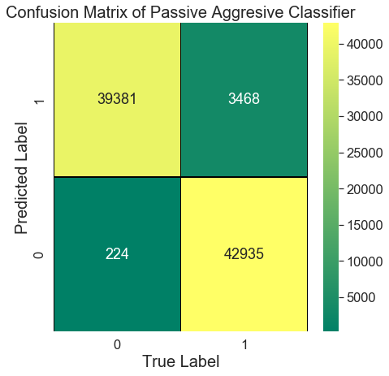
Passive Aggressive Classifier
In Passive Aggressive Classifier the accuracy score is 96%. Our Log Loss is 1.4. In the above we see the classification report and confusion matrix of model.

Slide 27
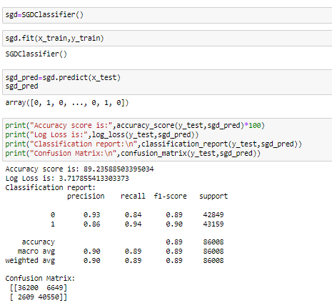
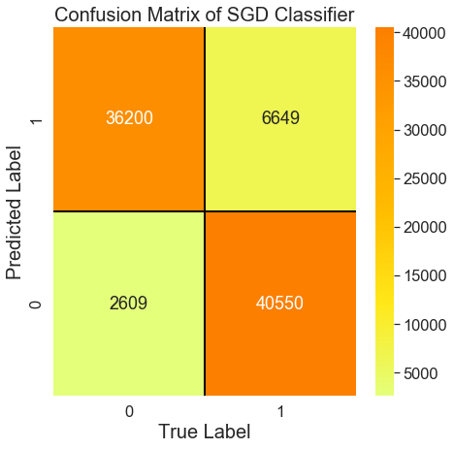
SGD Classifier
In SGD Classifier the accuracy score is 89%. Our Log Loss is 3.7. In the above we see the classification report and confusion matrix of model.

Slide 28

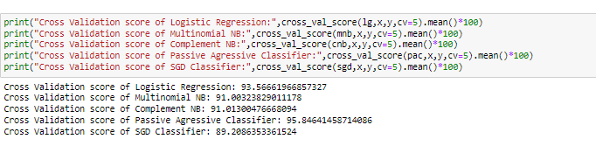
Cross Validation of All Models
On Analysis of various models and its cross validation score, we see that Passive Aggressive Classifier gives a good accuracy score 96%. So, I have consider the Passive Aggressive Classifier as my final model.

Slide 29

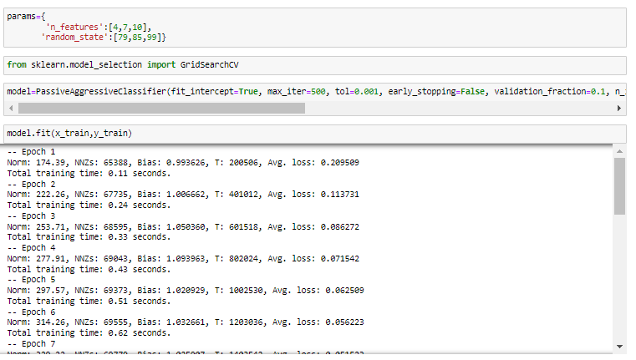
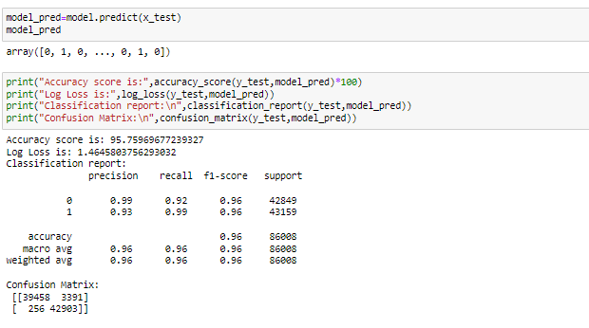
Hyper Parameter Tuning
After performed the hyper parameter tuning our model accuracy is increased a litter bit. 96% is a good accuracy. That our model Passive Aggressive Classifier has performed well.

Slide 30

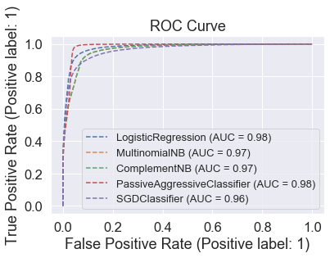
AUC ROC CURVE
In the above graph we see the ROC Curve of various model that we used in this project. Logistic Regression and Passive Aggressive Classifier gives a good AUC Score 98%. Which is a very good score.

Slide 31

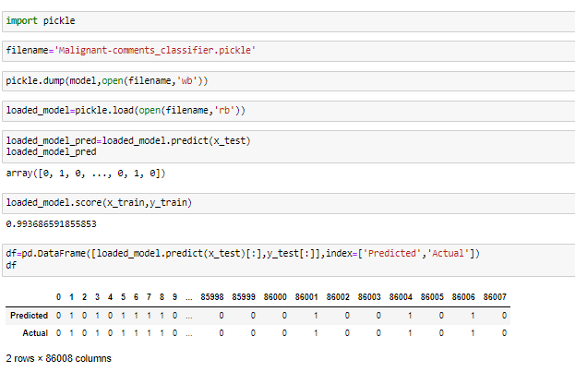
Saving the Final Model
We have saved our final model using the pickle and make the final prediction of comments. The predicted and actual value both are almost similar. That our model has performed well in making the prediction.

Slide 32
Conclusion
I have used various model to make the final prediction for this project. After analysis we have conclude that Passive Aggressive Classifier as our final model that has performed well.
Using the prediction the social media website can filter some keywords which are high malignant, abusive words from the comments. So, that we can stop spreading the hatred in the society.
In future we can prevent such type of comments that spread quickly in social media. That make the people to fight each other.
This project help me to understand on how to use the various visualization tool. I have used Natural Language Tool Kit to remove the unrelated words, punctuations from the comments.
This prediction will definitely help the social platform to prevent those comments and make peace among the people.

Slide 33
Thank you

